Slide 1

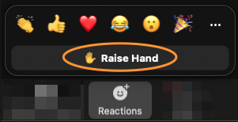
Survey
Your Feedback is important to us to shape our training and certification program:
Raise hand in Zoom when done!

Slide 2


